Slide 1
Investment Recommendation System
21PD03- Benny Abhishek M
For Buckman Problem Statement

Slide 2
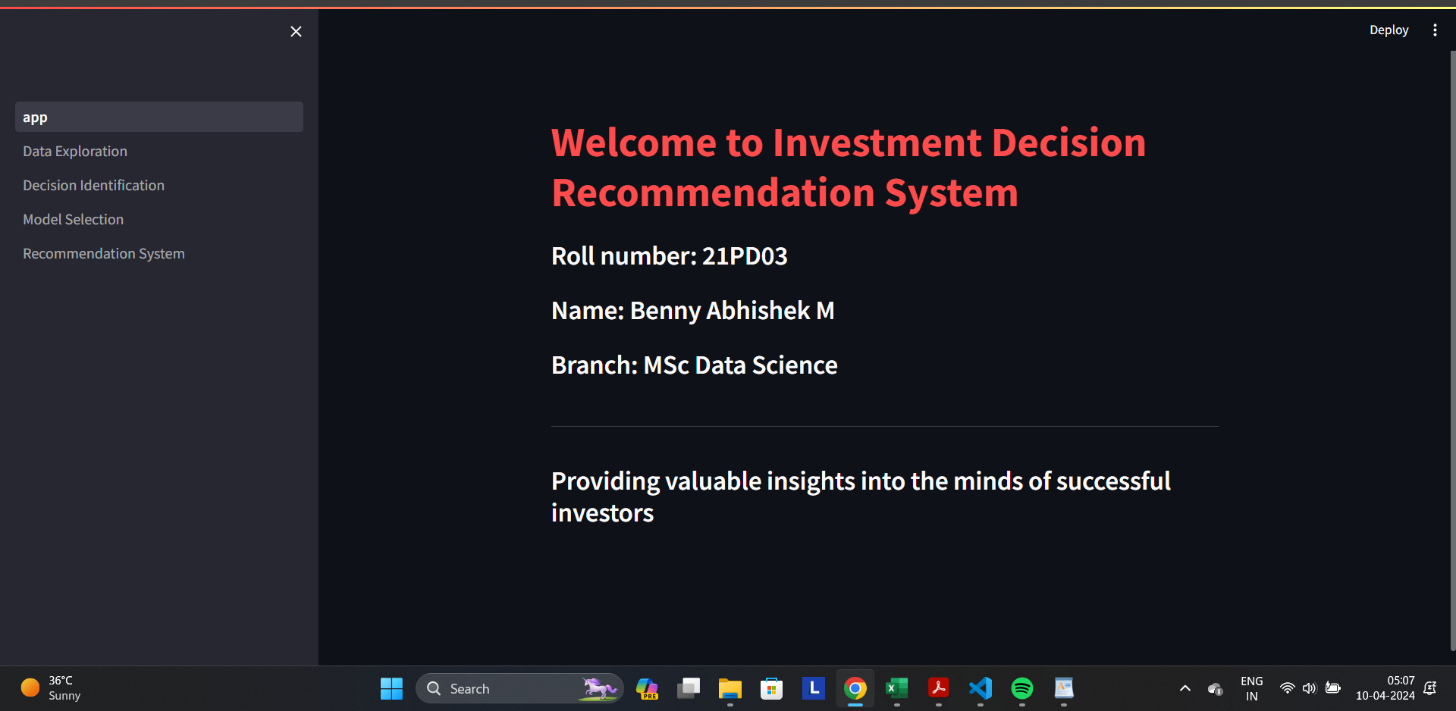
Welcome Page
The app starts with a Welcome page

Slide 3
DATA EXPLORATION
The data exploration page has plots of demographic distributions on the features Gender, Age, Marital Status and City
The another set of plots contain exploration of employment details using Education, Role and Income.
And the third set of plots have analysis on Investments Behaviour Insights on Household income, knowledge level, risk level etc.
Also other basic Exploratory data analysis(EDA) have been done .
NOTE: ANALYSIS USING POWERBI IS DONE AND SCREENSHOTS ARE ATTACHED AT THE END

Slide 4
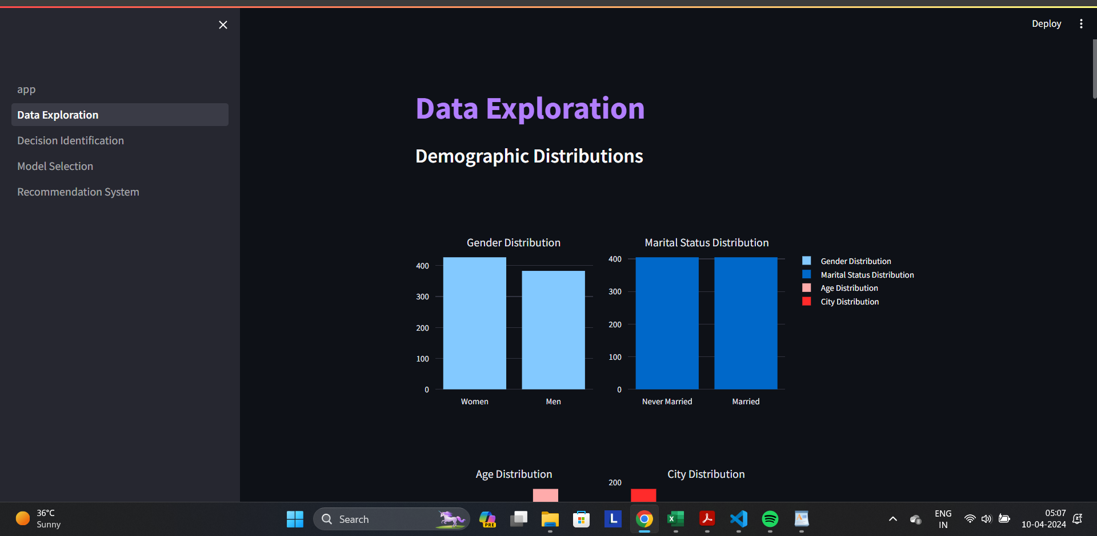
Output Screenshots

Slide 5
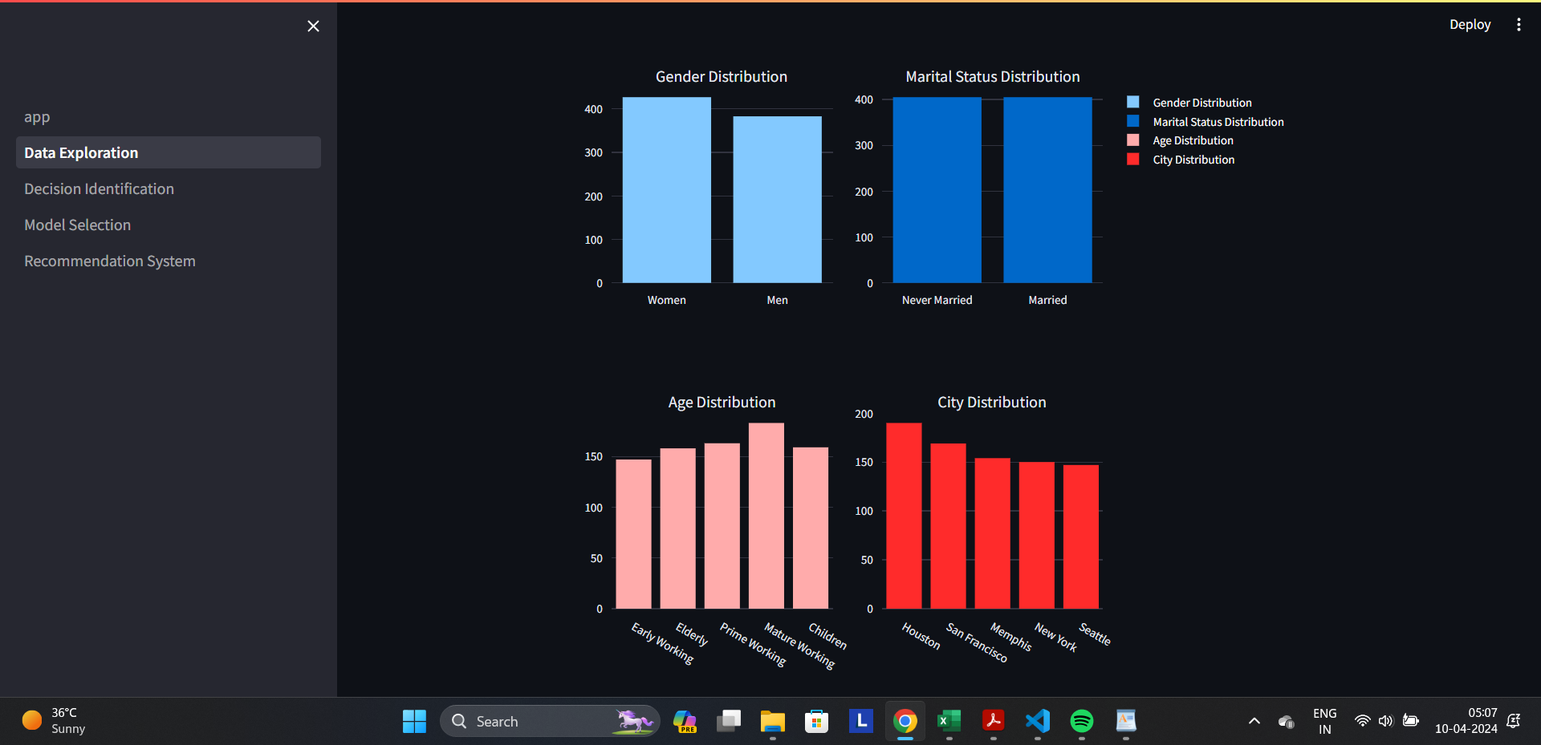

Slide 6
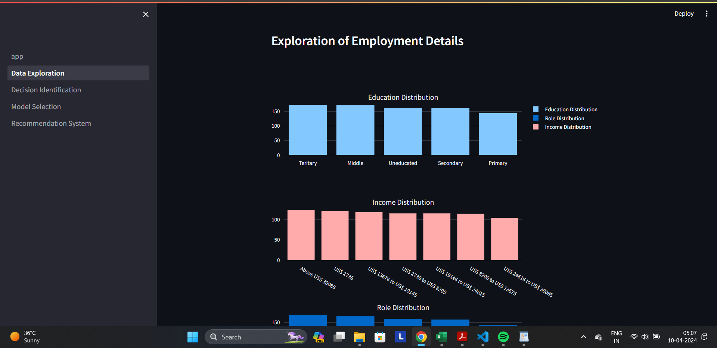

Slide 7
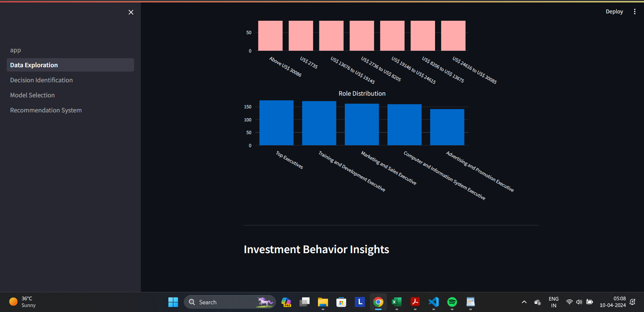

Slide 8
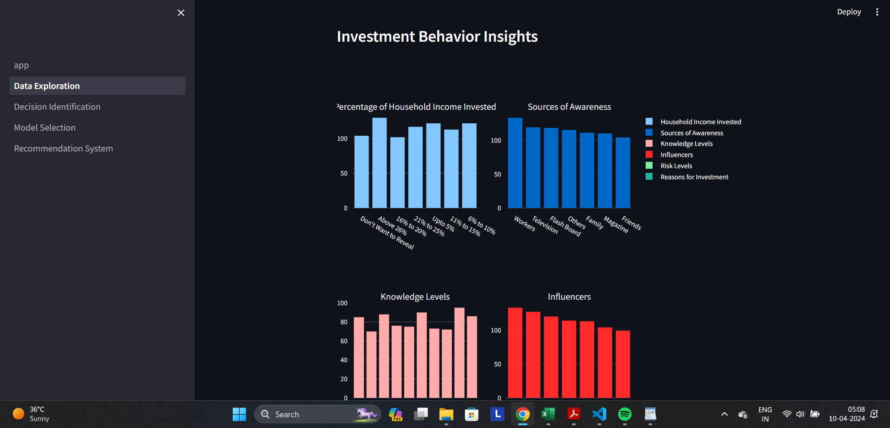

Slide 9
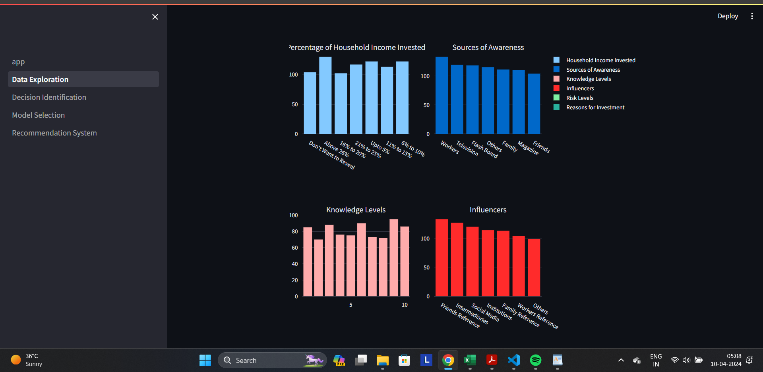

Slide 10
BEST INVESTMENT DECISION IDENTIFICATION
Since we are dealing with categorical data, the Chi-Square Test method has been used to find which features contribute more to the decision making.
(Significance value=0.5)
The “Return Earned” column is transformed to a numerical column of Return Scores as 4 being the most return, 1 the least and -1 for Negative returns.
Then the average return for each and every categorical value in every column is found to show for which values the returns are high.
This has been visualized in bar plots for easy interpretation.

Slide 11
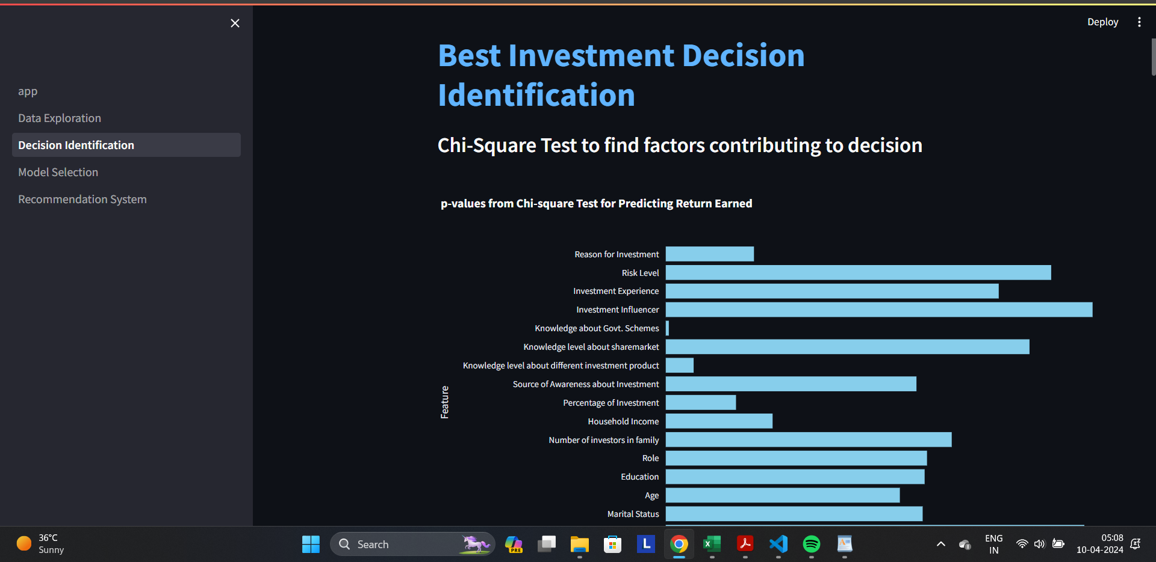

Slide 12
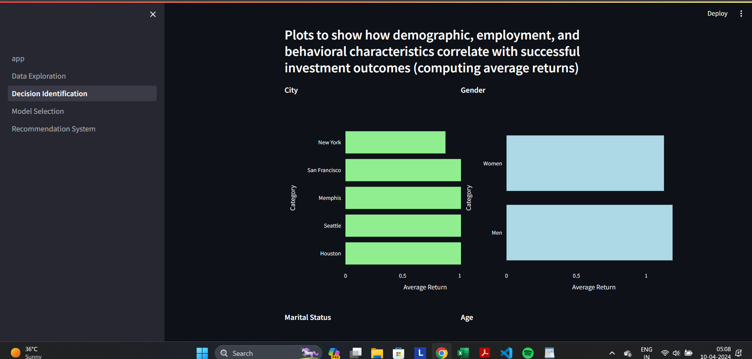

Slide 13
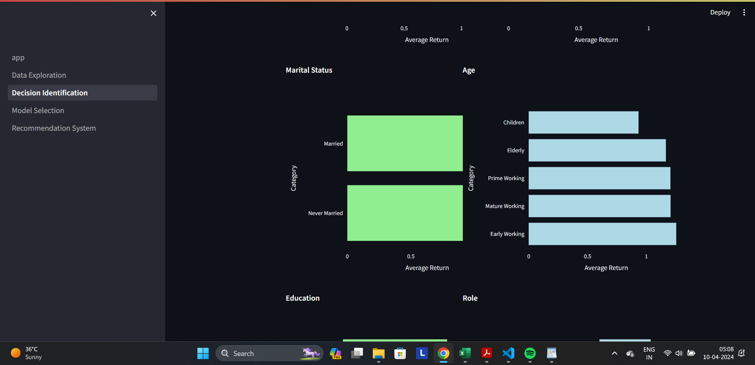

Slide 14
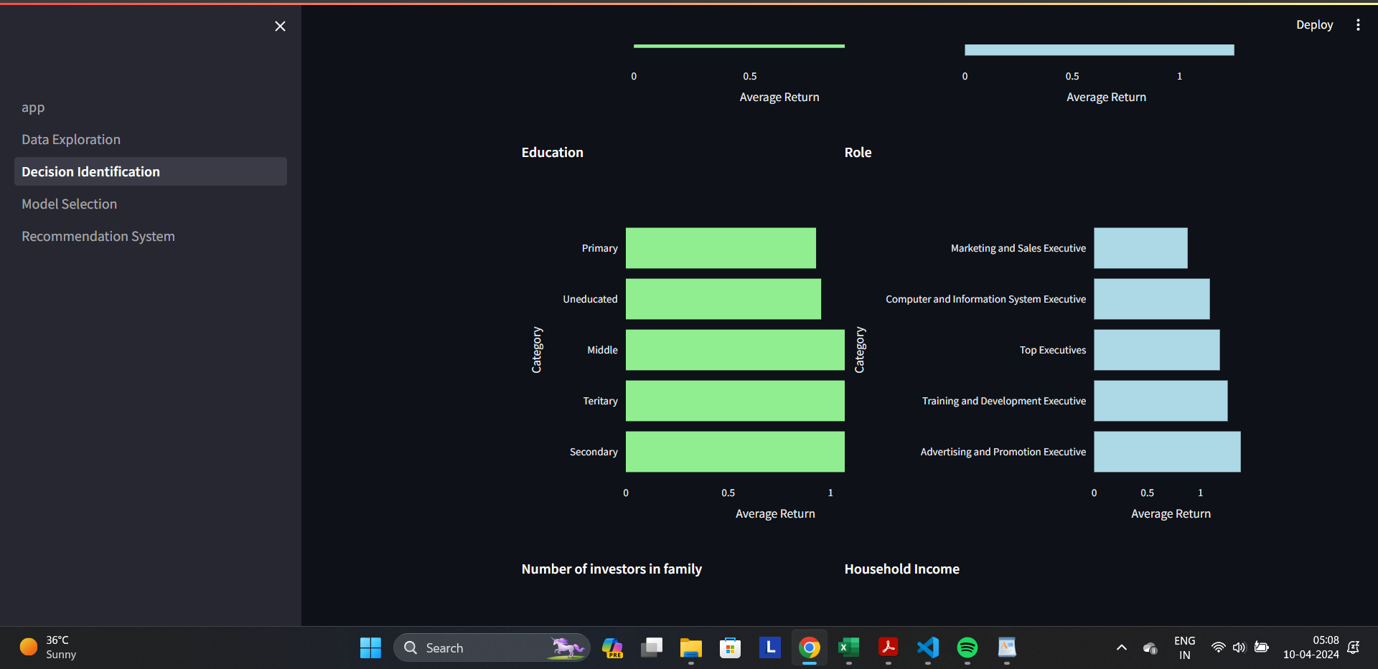

Slide 15
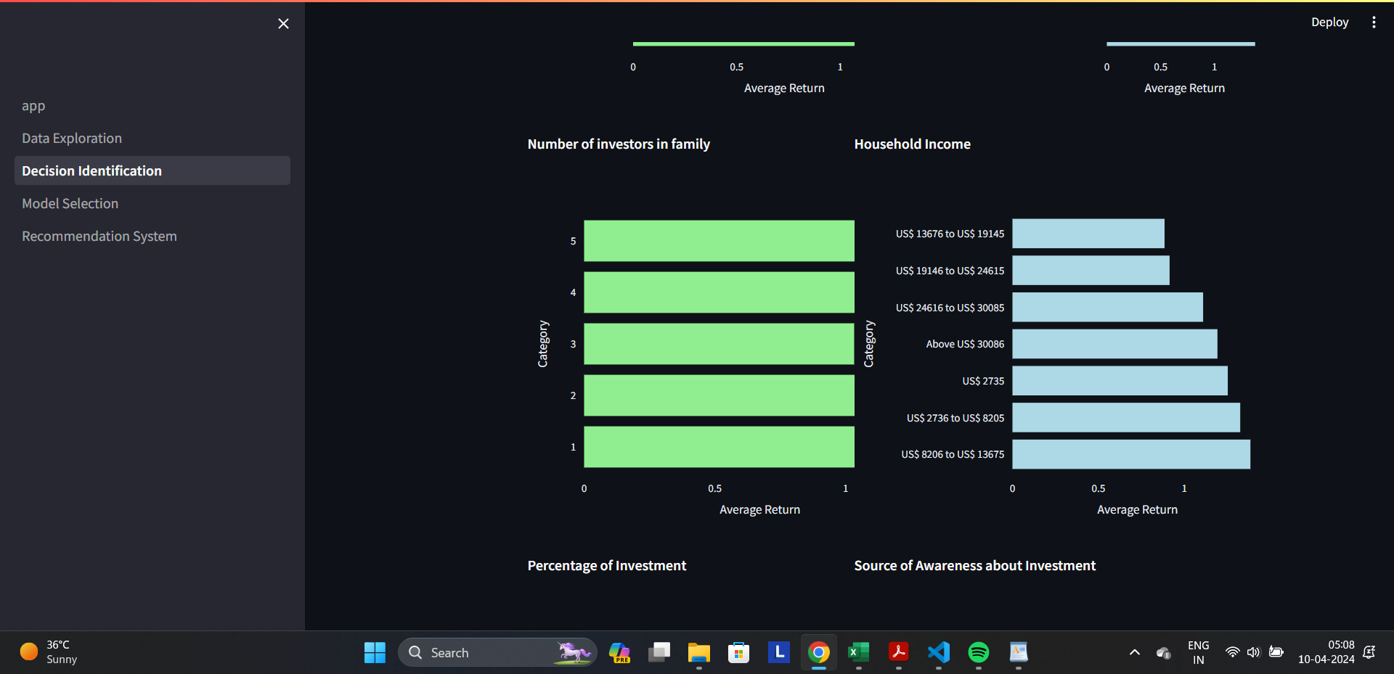

Slide 16
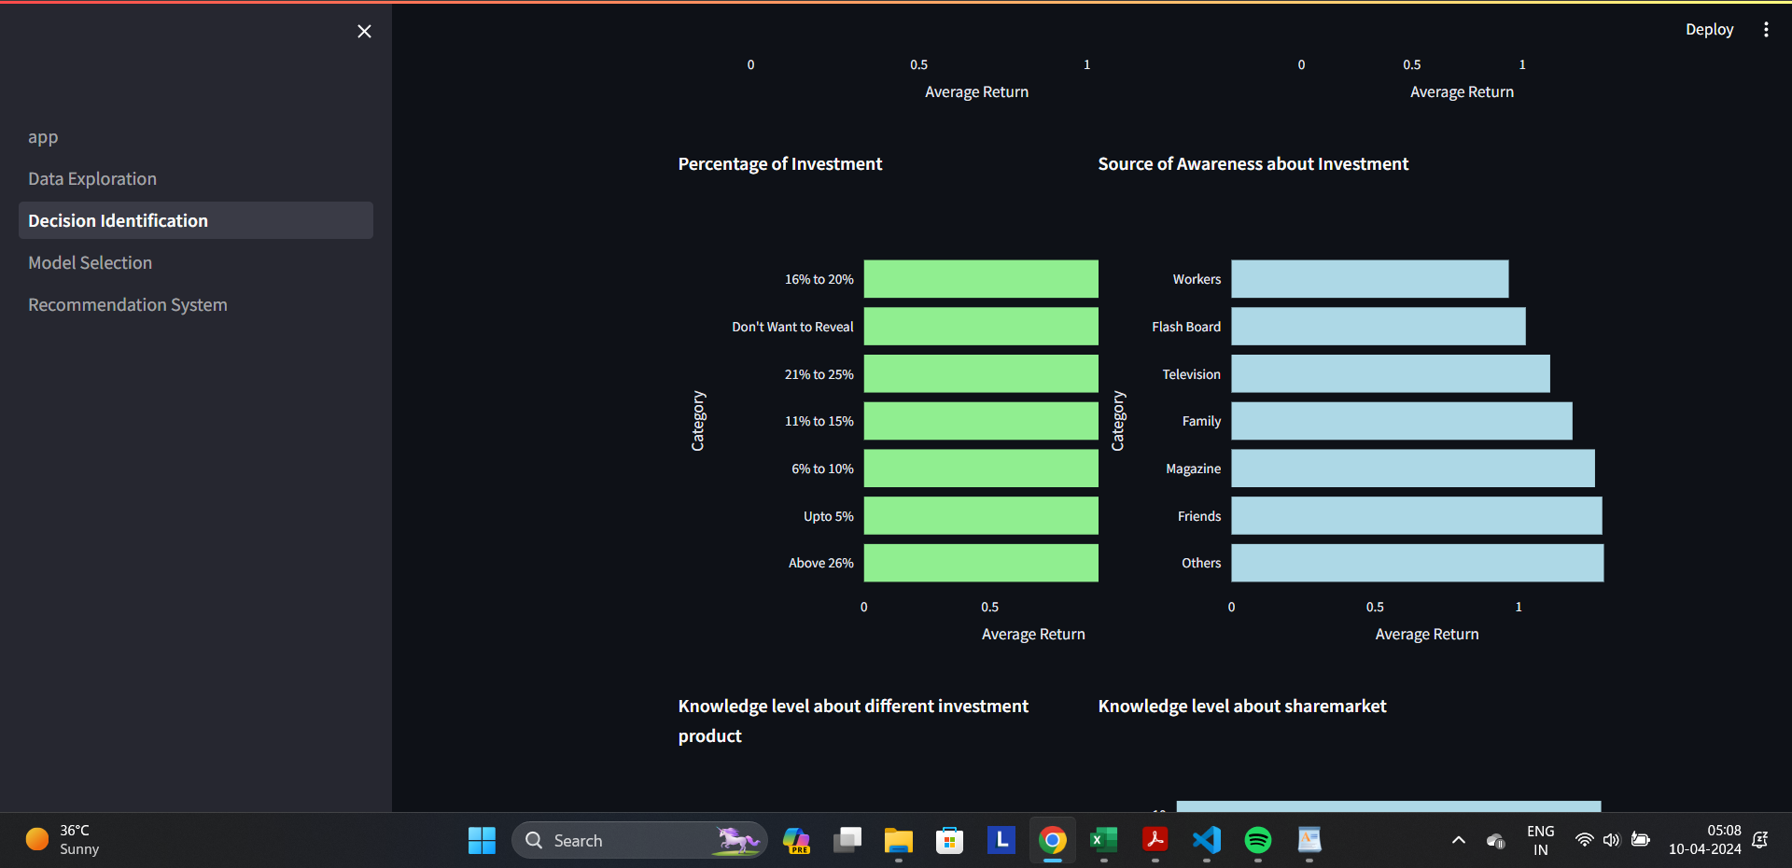

Slide 17
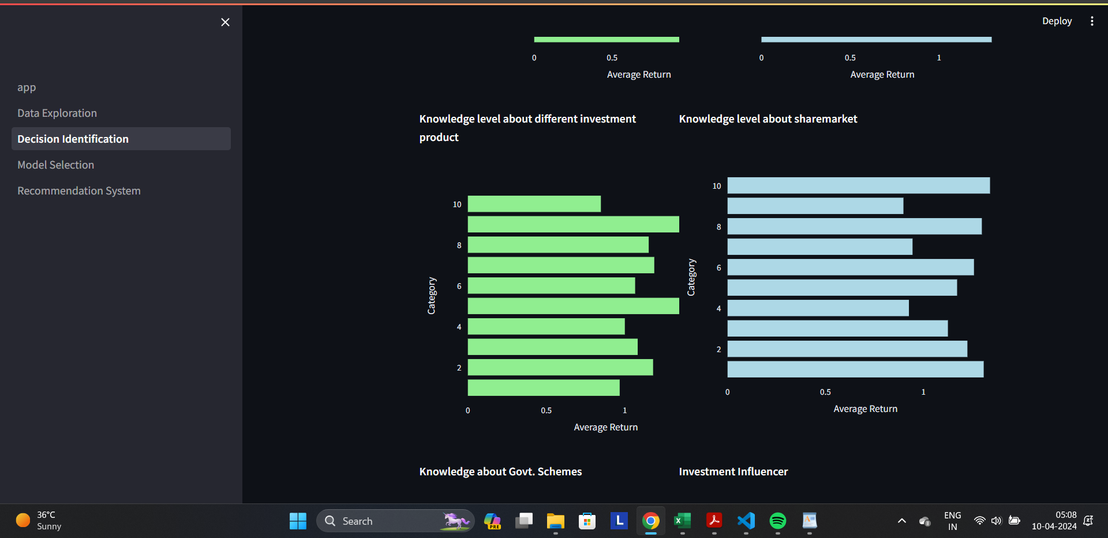

Slide 18
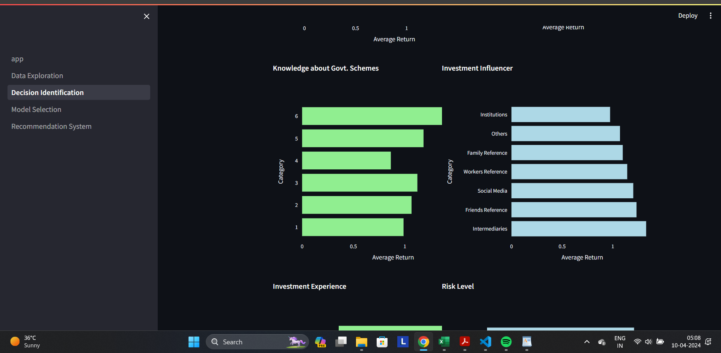

Slide 19
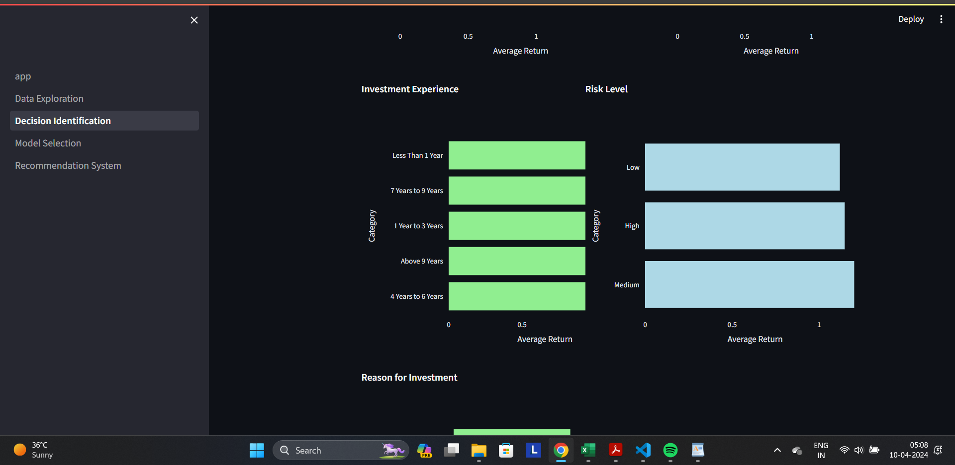

Slide 20
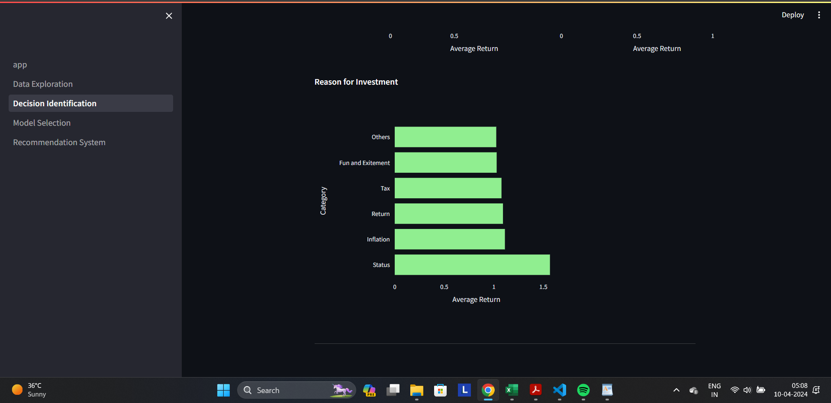

Slide 21
MODEL SELECTION & EVALUATION
Different ML algorithms like Decision Tree, Random forest, Multi-layer perceptron and Support vector machine are applied on the categorical dataset.
The parameters are tuned and the performance is measure using metrics like Accuracy, precision, recall and F1-score.

Slide 22
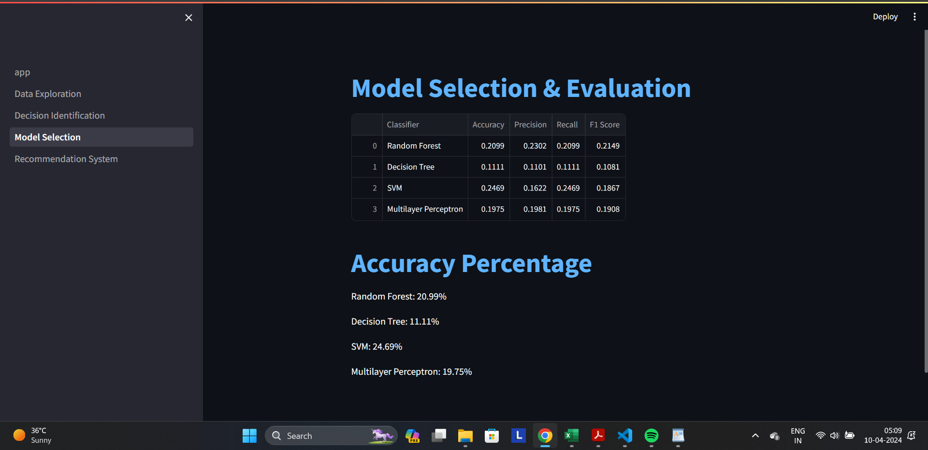

Slide 23
The Recommendation System
Then the best model is chosen to predict the returns based on the features affecting it, with the input gotten from the user through streamlit interface.
This prediction was found to be reasonably accurate even though the dataset is small.

Slide 24
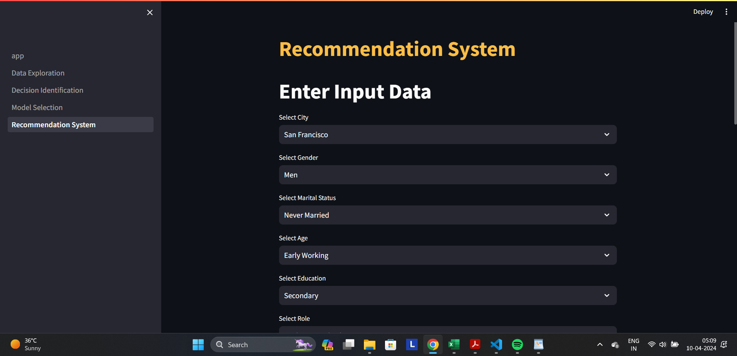

Slide 25
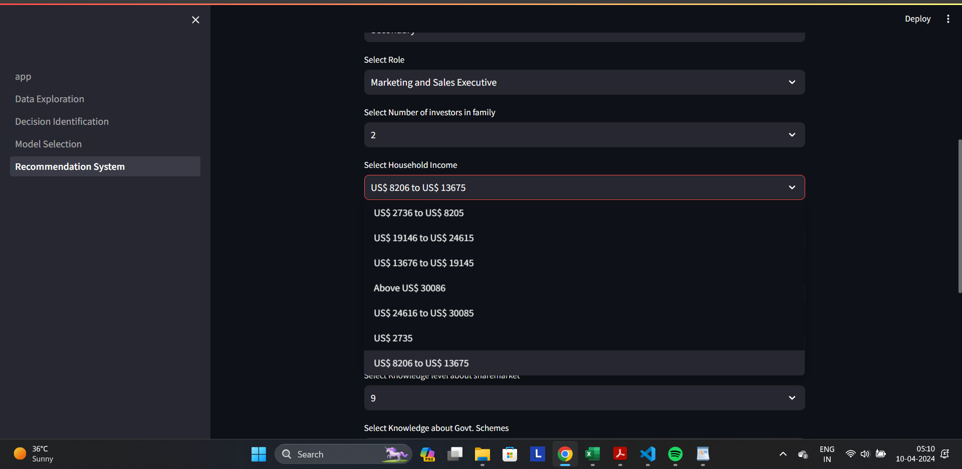

Slide 26
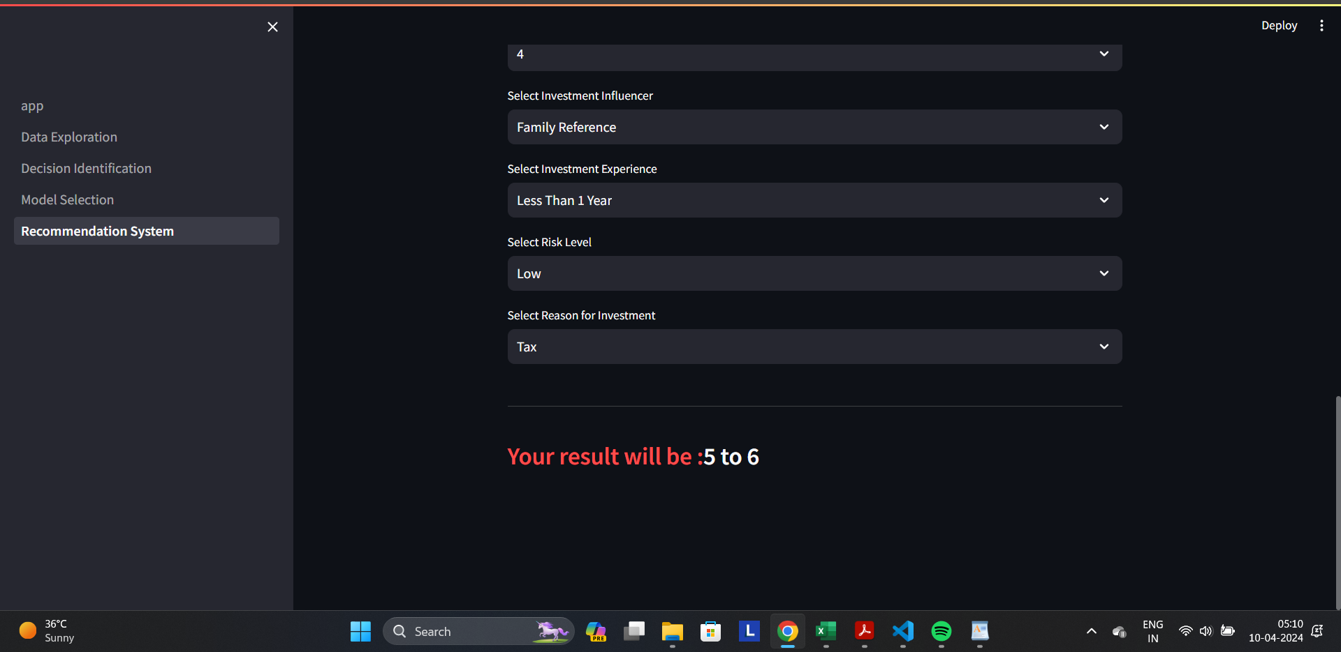

Slide 27
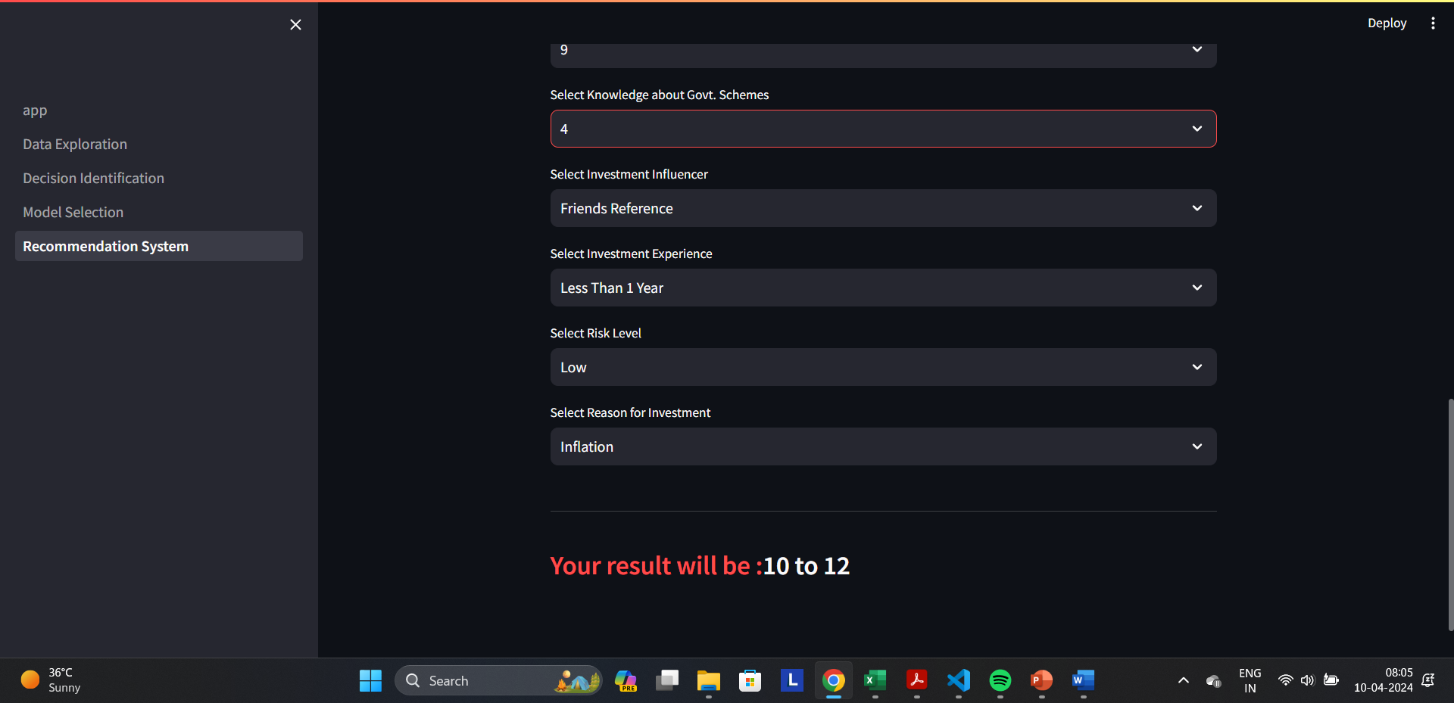

Slide 28


Slide 29
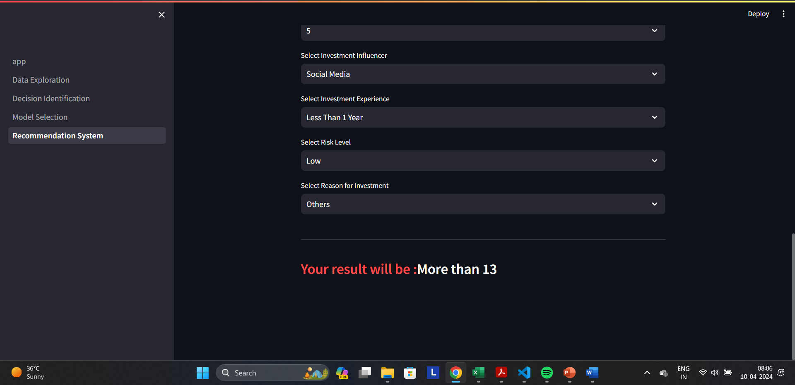

Slide 30

Power-BI Analysis
Analysis and data visualization has been done using PowerBi
Interactive plots for distribution analysis, Geographical spread and Cards are made.
Note: Screenshot has been added in the ppt but the .pbix file is added in the github repository.

Slide 31
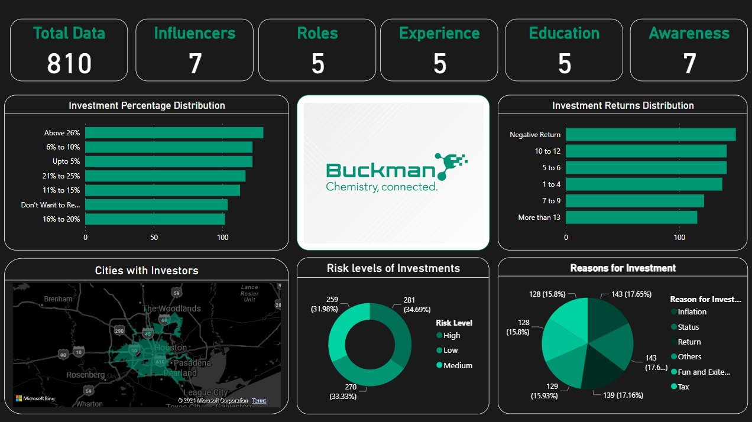

Slide 32
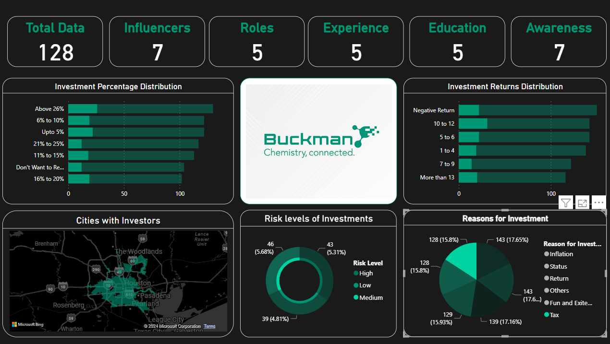

Slide 33
Conclusion - Inference
From the previous plots we infer that:
1)Knowledge is Power
2)Experience matters but so does adapting to trend
3)The more you invest the more you get
4)Higher the Risk, Higher the Profit.

Slide 34
IMPROVEMENTS
Given the time constraint, the model performs exceptionally, but in the future it can further improved.
Since, the dataset is small, collecting more data or performing data augmentation would make a drastic increase in the performance of the model.
A more enhanced user interface can be added for better usability.
Implement user authentication and session management to ensure secure access to the system and protect user data

Slide 35
THANK YOU

